Slide 1



Customer Lifetime Value & Engagement Insights
📊 Prepared by: Avni Dubey
📅 Date: October 2025
🏢 Organization: NMFC
Notes:
Test

Slide 2
Project Overview
Objective:
To integrate and analyse customer, sales, and engagement data to derive actionable insights for fan-based engagement and value segmentation.
Key Goals:
Calculate Customer Lifetime Value (CLV) – both historical and projected
Segment customers into CLV percentile bands
Analyse fan engagement and e-commerce behaviour
Build interactive dashboards to support strategic decision-making
Data Sources:
Customer Data
Sales Transactions & Membership Data
Merchandise Data
Fan Engagement (Tradable Bits)

Slide 3
🧹 Data Preparation & Cleaning
1. Filters & Exclusions
Selected only active customers from the customer and sales datasets.
Removed records with:
  Missing or invalid emails
  Internal club emails (@nmfc.com.au)
  Unknown email addresses
  Complimentary or non-membership sales
2. Data Merging & Enrichment
Customer + Sales Data: Merged to calculate:
  Historical & Projected Customer Lifetime Value (CLV)
  Revenue per year, average order value, and purchase frequency
BigCommerce Data:
Aggregated to extract:
  Total online orders, order value, and last purchase date
Tradable Bits Data:
Combined fan engagement from contests and digital content to compute engagement frequency
3. Deduplication & Final Dataset
Applied ROW_NUMBER() to retain the most valuable customer record based on highest e-commerce order value.
Final dataset includes:
  Demographics, CLV metrics, engagement counts, and e-commerce behaviour
  Segmented into CLV percentile bands for analysis

Slide 4


How We Calculate CLV: From Logic to Code
📘 Overview
Customer Lifetime Value (CLV) is a key metric used to understand the long-term value a customer brings to the business. In this project, CLV is calculated using two components:
1. Historical CLV
Represents the total revenue generated by a customer from paid membership orders, excluding GST.
Calculated by summing all non-complimentary, active membership transactions.
2. Projected CLV
Estimates the future value of a customer based on:
  Revenue per year
  Gross margin
  Retention rate
  Discount rate
This forward-looking metric helps prioritize high-value customers for retention and engagement strategies.
  Business Assumptions
    Retention Rate: 80%
    Discount Rate: 10%
    Gross Margin: 60%
Projected CLV = $\frac{\text{Revenue} \text{per} \text{Year} × \text{Gross} \text{Margin} × \text{Retention} \text{Rate}}{1+\text{Discount} \text{Rate}−\text{Retention} \text{Rate}}$

Slide 5
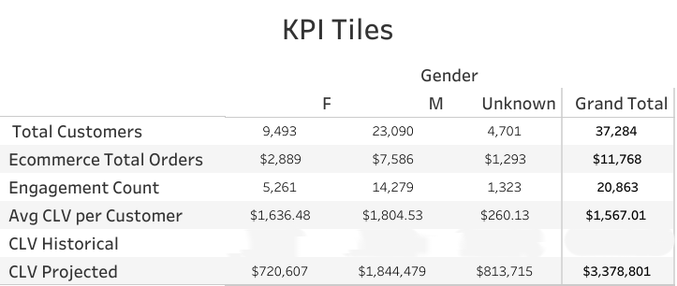
Key Parameter Index
Customer Value Snapshot
To provide a quick, high-level view of overall customer value and engagement, helping stakeholders gauge the health of the customer base.
Number of Customers
Active, deduplicated
[N]
E-commerce Total Orders
Across BigCommerce
[Orders]
CLV
Historical + Projected
$[Total]
Average CLV per Customer
Benchmark vs acquisition cost
$[Avg]
Engagement Count
Total fan interactions
[Count]

Slide 6
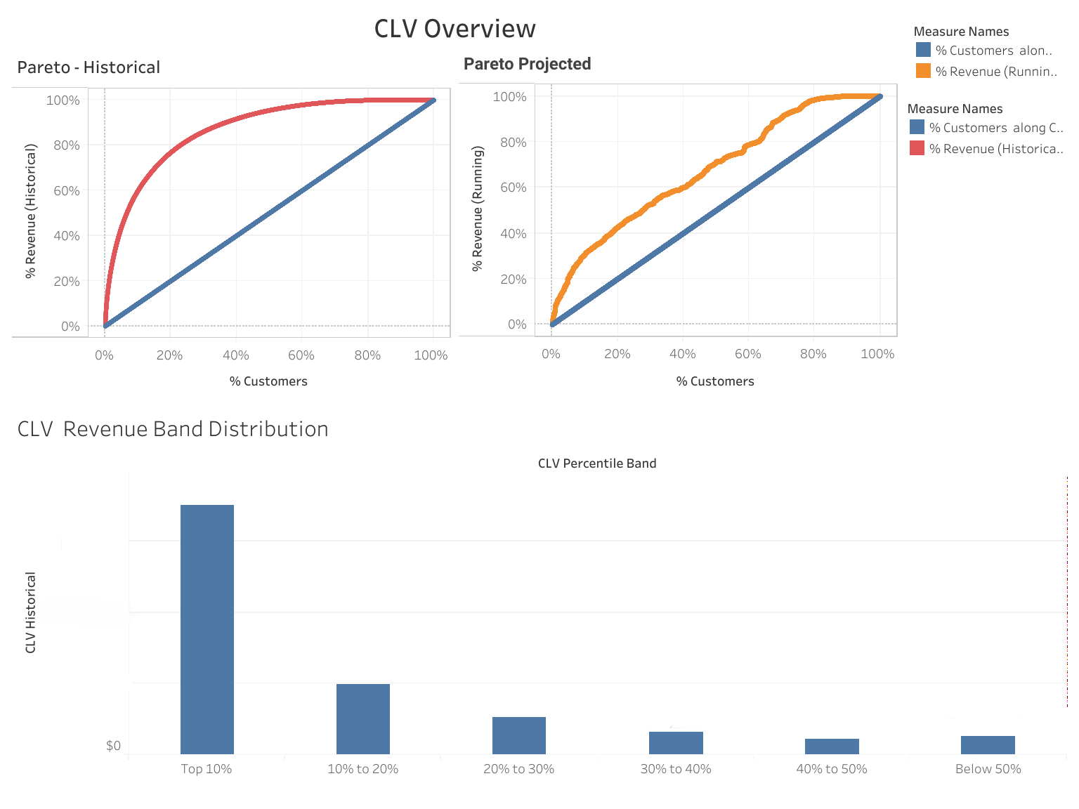
CLV Overview Dashboard
To reveal revenue concentration and identify high-value customer segments for strategic targeting..
Interpretation Guide:
  CLV Distribution (Historical & Projected): Shows how customer value varies across the base, highlighting the skew between past performance and future potential.
  Pareto Curve Confirms the 80/20 rule as top 20% of customers contribute ~70% of revenue
  CLV Band Segmentation: Segments customers into actionable tiers (Top 10%, 10–20%, etc.) for campaign prioritization.
Business Use:
  Focus retention campaigns on top CLV bands.
  Identify mid-tier customers for upsell opportunities.
  Validate revenue concentration for resource allocation.

Slide 7
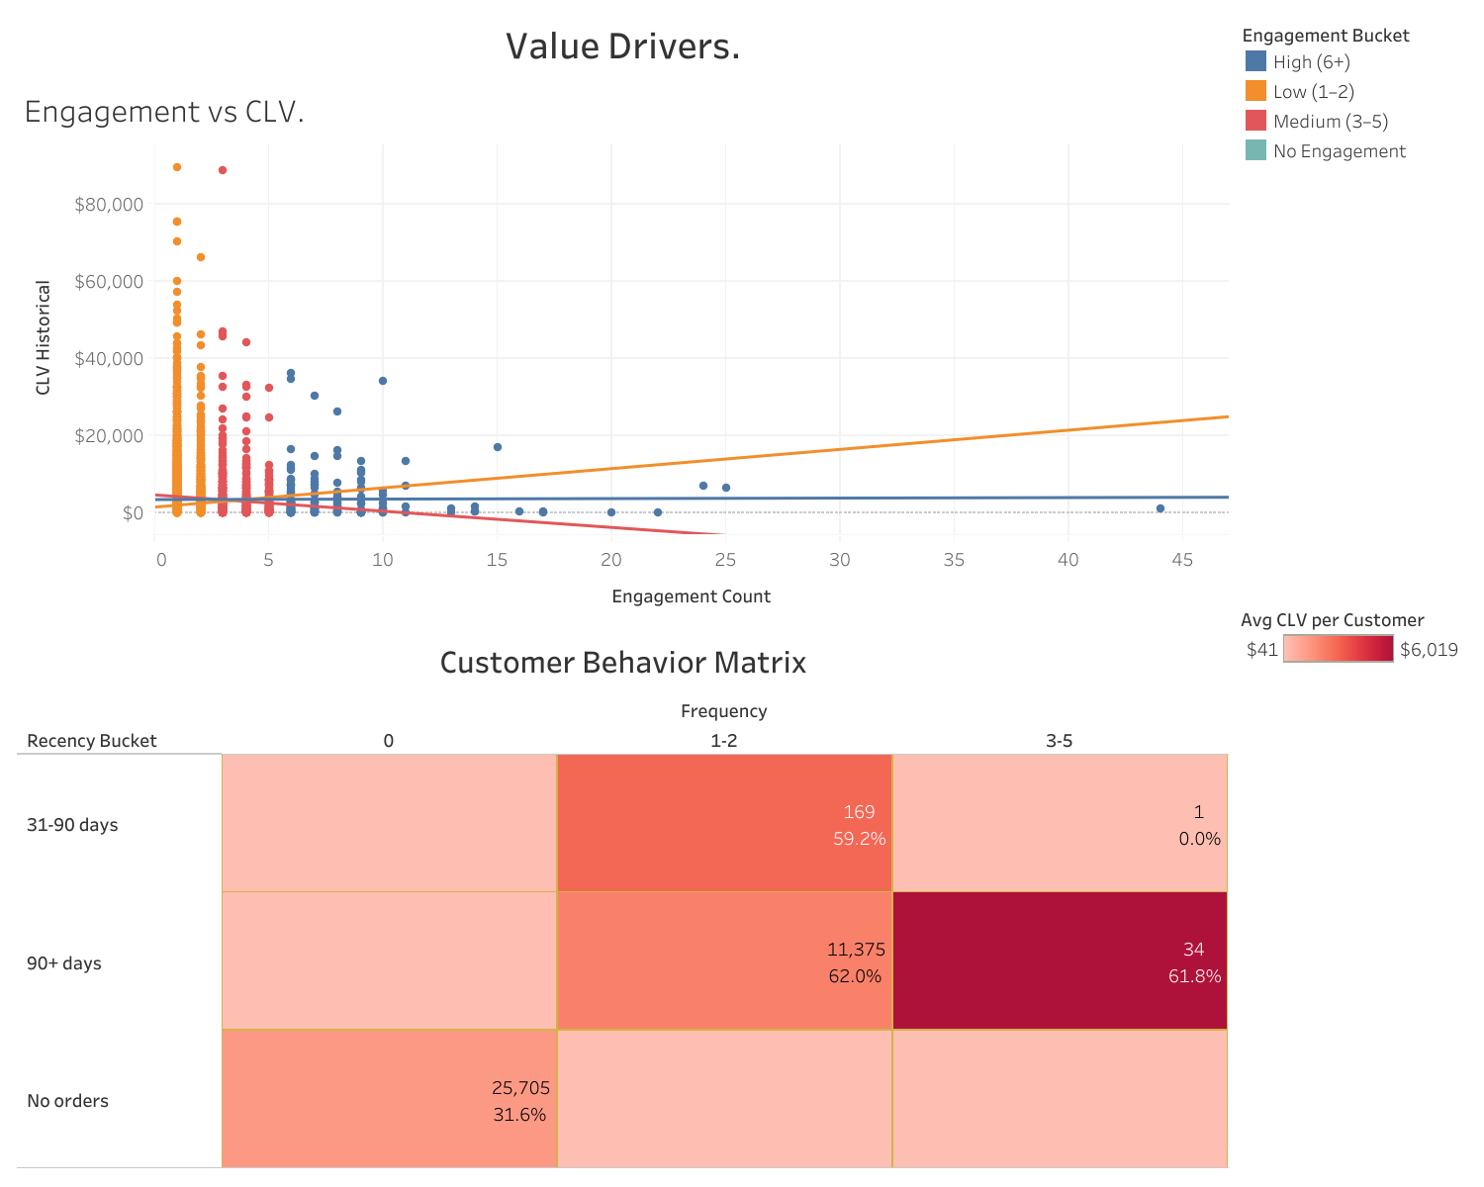
Value Drivers Dashboard
To pinpoint targeted retention and engage behavioural and tenure-related factors that drive Customer Lifetime Value (CLV), enabling strategies.
Interpretation Guide:
  Engagement vs CLV Scatter: Reveals correlation between engagement and CLV; high-engagement, low-CLV customers are prime upsell targets.
  Tenure × Frequency Heatmap: Segments customers by how recently and frequently they’ve made e-commerce purchases.
  Each cell shows engagement % to highlight where digital interactions are strongest or weakest.
  Business Use:
  Target upsell offers to engaged fans with low CLV.
  Reinforce loyalty benefits for long-tenure, high-frequency members.
  Design engagement boosters for short-tenure segments to improve retention.

Slide 8
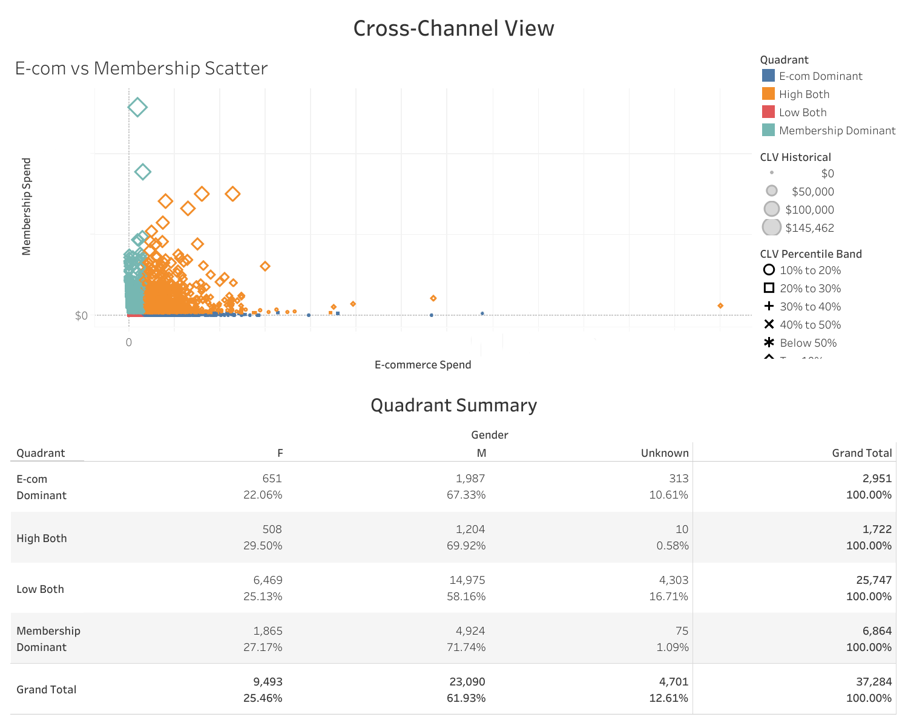
Cross-Channel Value: E-commerce vs Membership
To understand how customers allocate spending between membership and e-commerce channels, enabling cross-sell and upsell strategies.
Interpretation:
Scatter Plot: Most high-membership customers have low e-commerce orders — a clear opportunity for merchandise campaigns.
Quadrants:
  Top-Right: Omnichannel champions (high membership + high e-commerce).
  Top-Left: Strong members, low merchandise → target with e-commerce offers.
  Bottom-Right: Merchandise-heavy, low membership → upsell memberships.
  Bottom-Left: Low-value customers → minimal focus.
Business Use:
  Promote merchandise to high-membership, low-e-commerce customers.
  Offer membership upgrades to merchandise-heavy customers.
  Reinforce loyalty for omnichannel champions.

Slide 9
Turning Insights into Action
Summarize what the previous dashboards (CLV Overview, Value Drivers, Cross-Channel View) reveal and translate them into clear business moves.
Retention Focus: Reinforce loyalty for top CLV segments and omnichannel champions.
Upsell Opportunities:
Merchandise offers for membership loyalists (high membership, low e-commerce).
Membership upgrades for merchandise fans (high e-commerce, low membership).
Engagement Boost: Target short-tenure, low-frequency customers with onboarding campaigns.
Personalization: Use CLV bands and engagement signals to tailor offers and NBA (Next Best Action) recommendations.

Slide 10
Key Takeaways & Thank You
To summarize the main insights and leave the audience with a clear next step
Revenue is concentrated in top CLV segments — retention is critical.
Engagement and tenure drive value — boost mid-tier engagement.
Cross-channel gaps exist — merchandise and membership upsell opportunities.
Action plan ready — targeted campaigns and NBA integration.

Slide 11
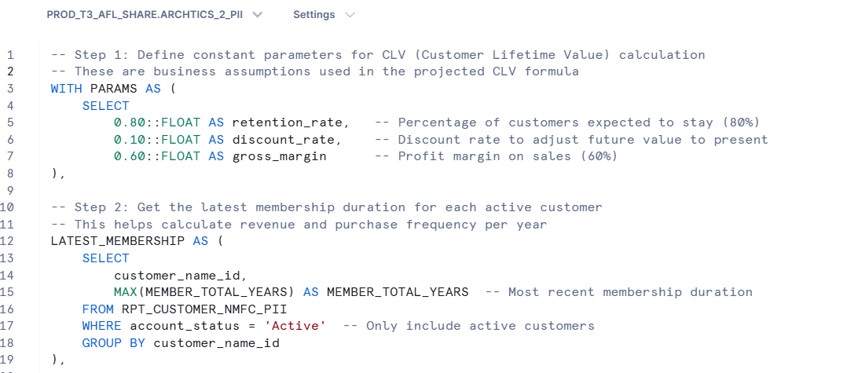
Appendix

Slide 12
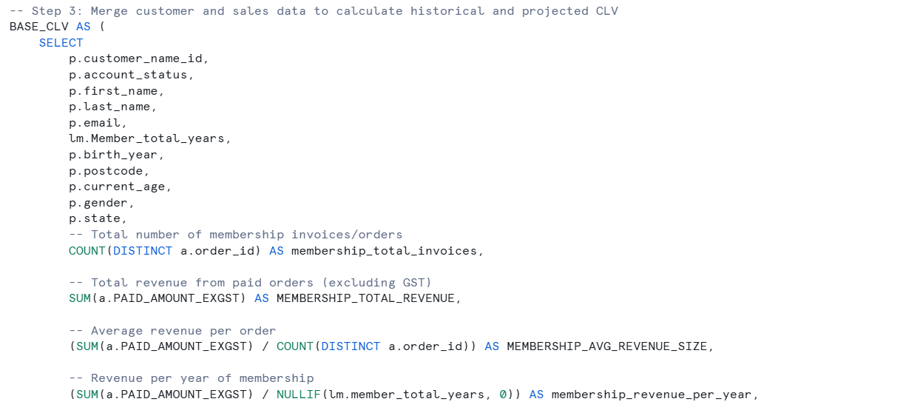
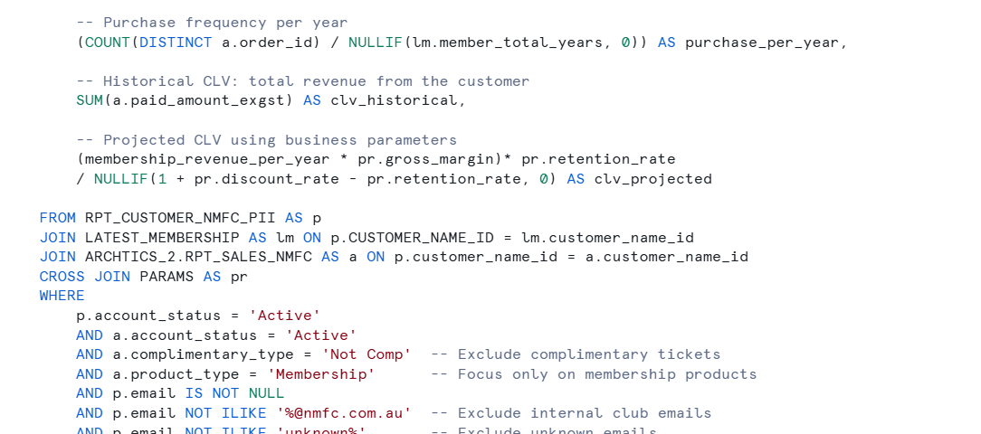

Slide 13
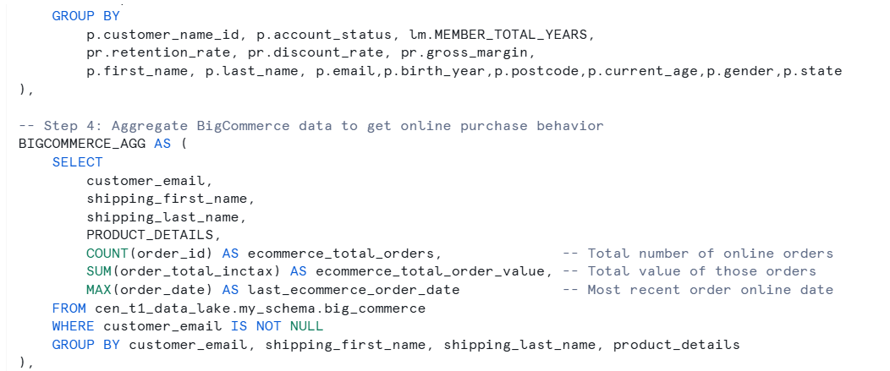
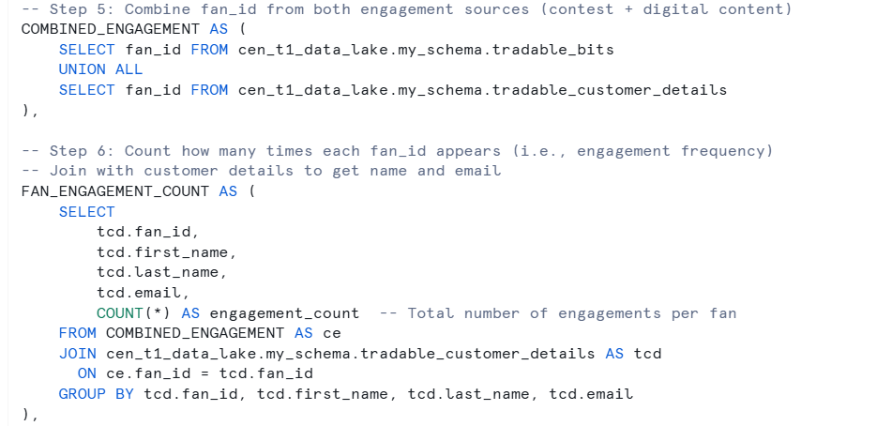

Slide 14
